Slide 1
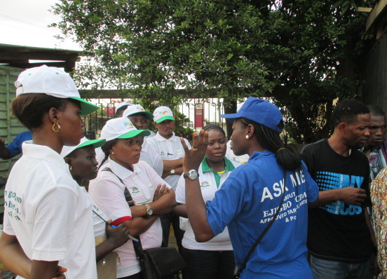
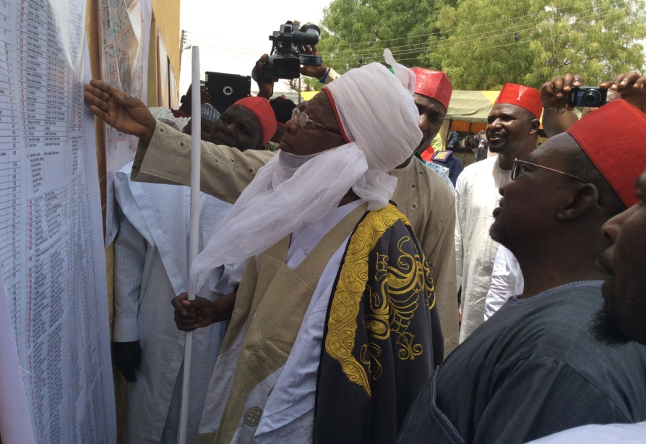
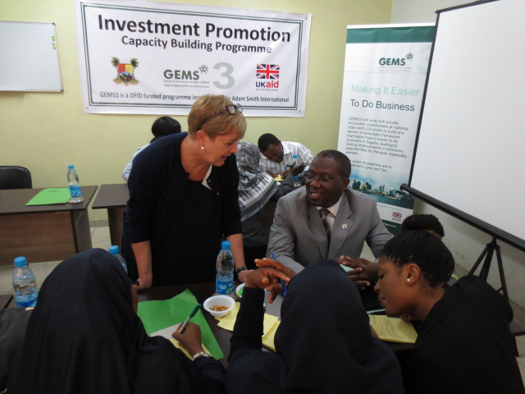
GEMS3 – Tax Reform Programme
Presentation to NGF Peer Learning Event

Slide 2
GEMS3’s core toolkit
Legislation
To ensure tax payers have clear rights and responsibilities.
Grounded in PPD
New Stamp Duty legislation (Federal)
LGA Harmonised Rates and Levies Law (State)
MDA Tax Harmonisation Law (State)
By-laws covering LGA tax harmonisation in Cross River (LGA)
Incentives
To build taxpayer confidence in system and payment compliance
  Tax for Service Agreements
  Tax Complaints Procedures
Payment Systems
To improve accountability of revenue collectors.
Point of Sales (POS) machines
Harmonised demand notices
Direct Lodgement
Awareness
To build communities that know their rights and responsibilities in relation to tax
Training for public sector
Awareness campaigns

Slide 3
Benefits for States & Stakeholders
Direct benefits to the taxpayer
Awareness of rights and responsibilities
Greater transparency in tax system
Services delivered in return for tax payments
Reduced harassment
Direct benefits to the state
Full legal authority for revenue collections
Reduced IGR leakages through improved tax payment systems
Increased IGR through improved compliance
Many LGAs have experienced 200-300% increases in IGR

Slide 4



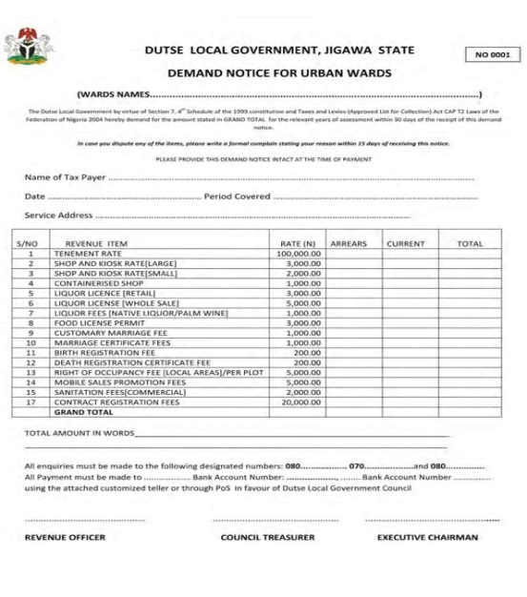
GEMS3 tax reform in action
POS in Cross River
Sensitisation in Lagos
Harmonised Demand Notice in Jigawa
Tax for service in Kaduna

Slide 5
GEMS3 is always innovating and expanding its approach
Recent ideas have included:
Automation
GEMS3 recently commissioned a feasibility study into the automation of state level tax systems
We are now carrying out a full project design in a pilot state.
Presumptive income tax
  New presumptive income tax rules have been agreed by the JTB and will be rolled out across Nigeria shortly
  GEMS3 will work with our partners in the public and private sector to ensure the rules are properly implemented
Training of trainers
GEMS3 is working to embed our reforms by training officials who can train others in GEMS3 tax reform techniques

Slide 6
GEMS3 has implemented tax reform in 8 states
Katsina
Jigawa
Zamfara
Kano
Kaduna
FCT
Kogi
Lagos
Cross River
GEMS3 State & Federal

Slide 7
We are now looking to expand to new states – working with partners
Katsina
Jigawa
Zamfara
Kano
Kaduna
Niger
FCT
Plateau
Kogi
Ogun
Ondo
Lagos
Cross
River
Core State & Federal
Some ongoing support
Confirmed partner states

